Slide 1
Xamarin Native Cross Platform Development with C#
Jon Worthington
October 11, 2016

Slide 2
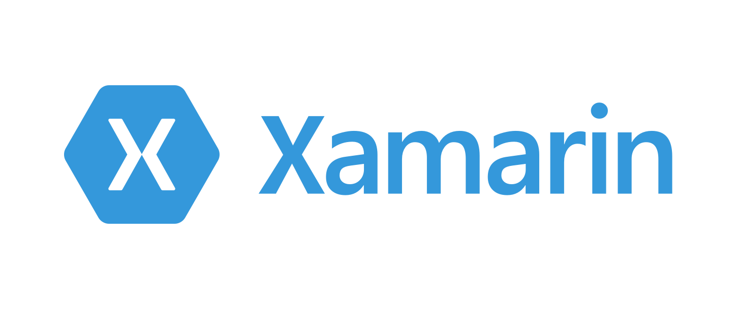
What is Xamarin?
Xamarin allows developers to build native apps for Android, iOS, and Windows using a shared C# codebase. Use the same IDE, language, and APIs everywhere.

Slide 3
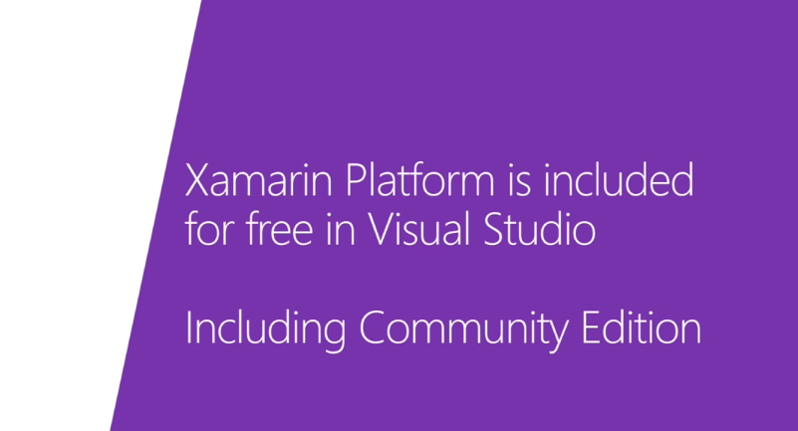
What does Xamarin cost?
On March 18th, 2016 Microsoft Acquired Xamarin and made it free and open-source for everybody.

Slide 4
Get Xamarin Today
Visual Studio 2015 Installer on Windows
http://www.xamarin.com/download

Slide 5
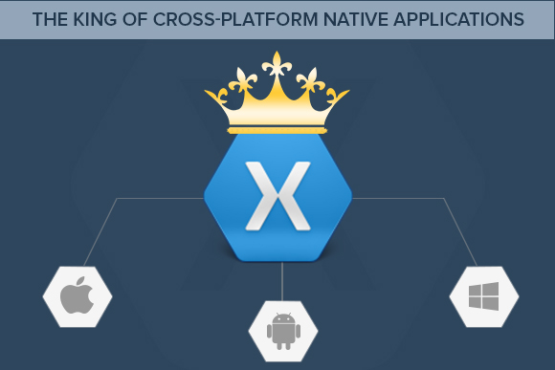
Why Xamarin?
Use a single team and single C# codebase for all your mobile apps
You get 100% native API access to iOS, Android and Windows.
Anything you can do in Object-C, Swift, or Java can be done in C# natively with Xamarin.
Native performance
Xamarin is fully open-source and free to use.

Slide 6
Why Native?
Your want your app to look and feel correct on each platform.
You don’t just want it to feel “like” that platform – it needs to “be” that platform.
You want access to every API, library and device specific asset on that platform.
You want native performance and want to be able to get down to the bare metal of each platform.

Slide 7
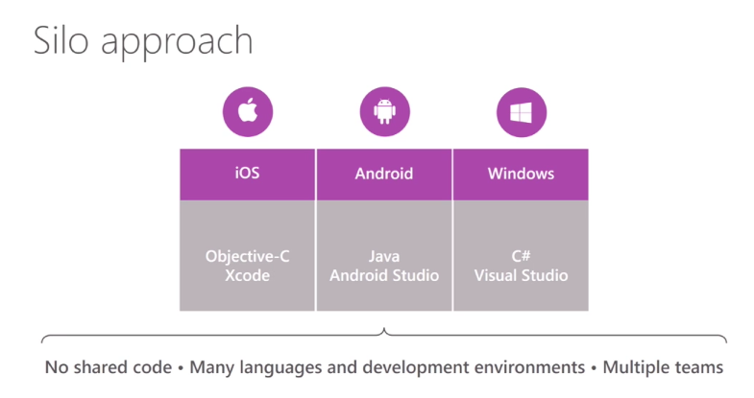
Silo Approach
Requires a separate team of developers for each OS, each using different tools.
Requires you to build the app once for each platform.
There is no shared code.
Can get really expensive really fast.
All teams must work together.

Slide 8
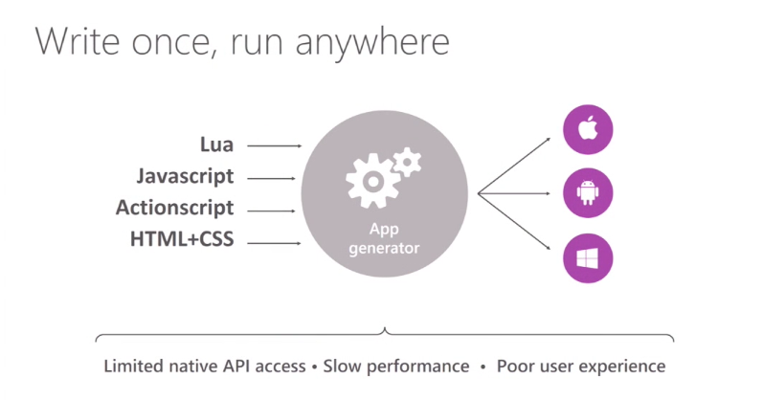
Write once, run anywhere
Not really native
Often uses an embedded web browser to simulate a native experience.
Not actually using the native api.
Hard to get native performance

Slide 9
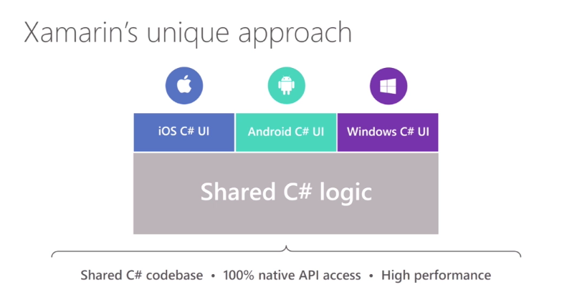
Xamarin’s Approach
Xamarin allows you to use C# for your entire codebase across iOS, Android and Windows.
You have 100% Native API access
Native Performance
You can share C# logic
But still have platform specific UI layers that “are” that platform.
Xamarin gives you a purely native application.

Slide 10
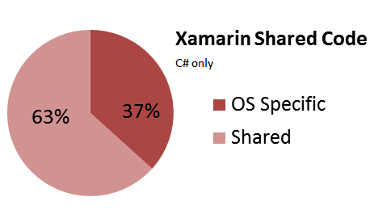
Code Sharing Stats
Share up to 70% of your code in most cases
Allows you to leverage platform specific code
Or do everything in Xamarin Forms and have 100% shared code.

Slide 11
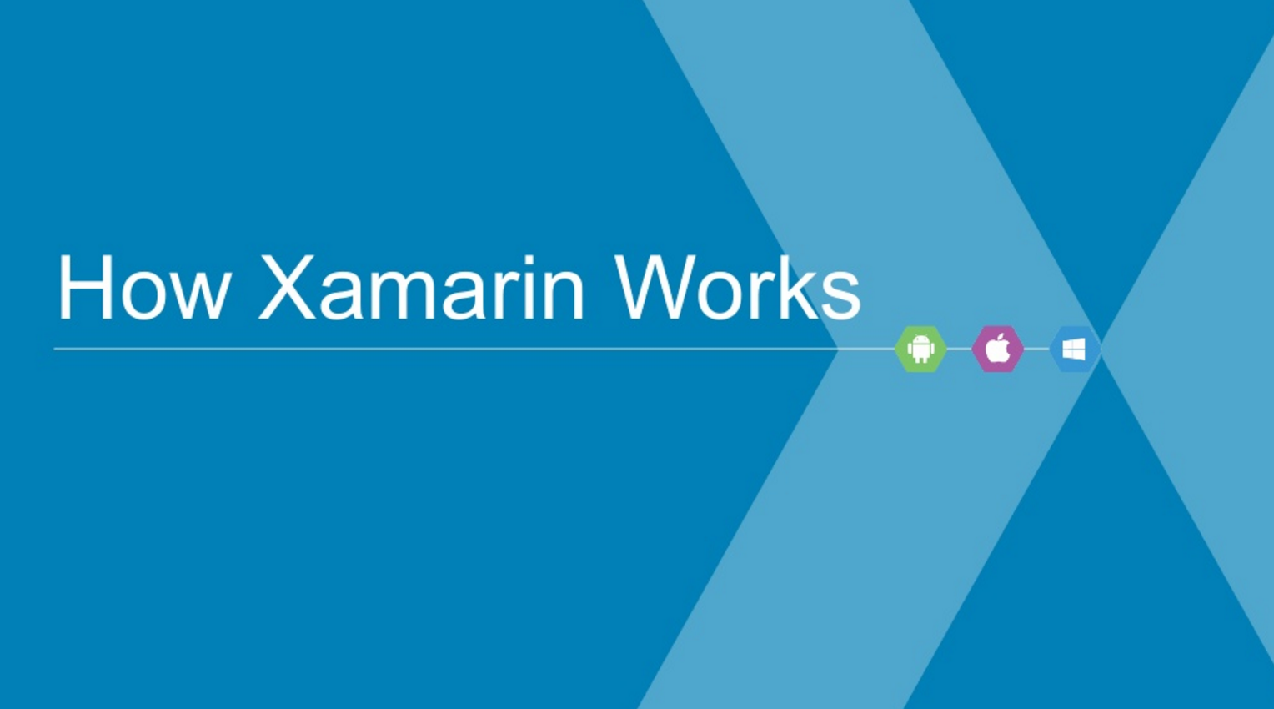
How does Xamarin work?
Xamarin.iOS and Xamarin.Android are both built on top of Mono – an open source version of the .Net Framework.
C# Bindings for every single API on iOS and Android have been created.

Slide 12
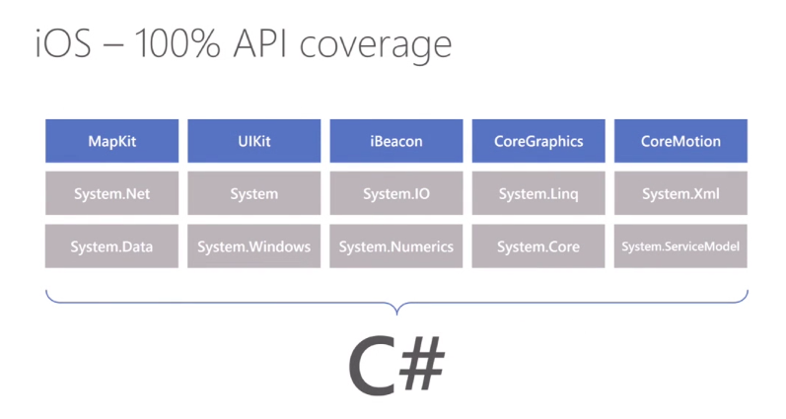
How does Xamarin work?
In iOS, Xamarin’s Ahead of Time (AOT) Compiler compiles Xamarin applications directly to native ARM assembly code.
When Xamarin applications are compiled, the result is an Application package:
iOS - .app file
These files are indistinguishable from application packages built with the platform’s default IDEs and are deployed in the exact same way

Slide 13
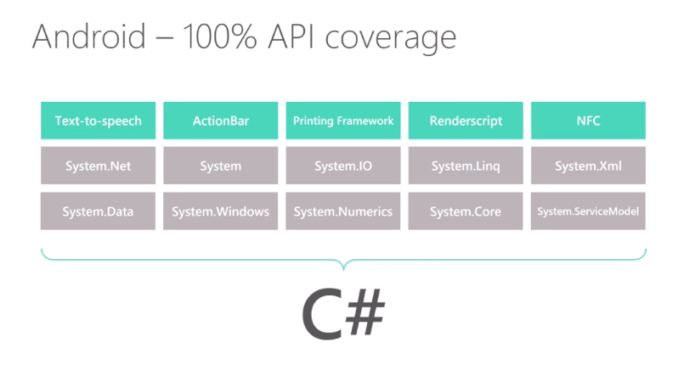
How does Xamarin work?
On Android, Xamarin’s Compiler compiles down to Intermediate Language (IL), which is then Just-in-Time (JIT) compiled to native assembly when the application launches.
When Xamarin applications are compiled, the result is an Application package:
Android - .apk file
These files are indistinguishable from application packages built with the platform’s default IDEs and are deployed in the exact same way

Slide 14
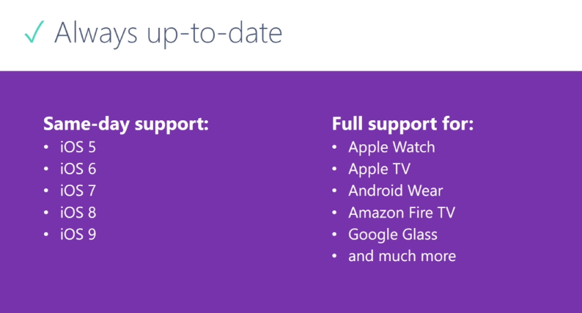
Xamarin – Always up-today
Same day support for new versions of iOS
Near same day support for new versions of Android.

Slide 15
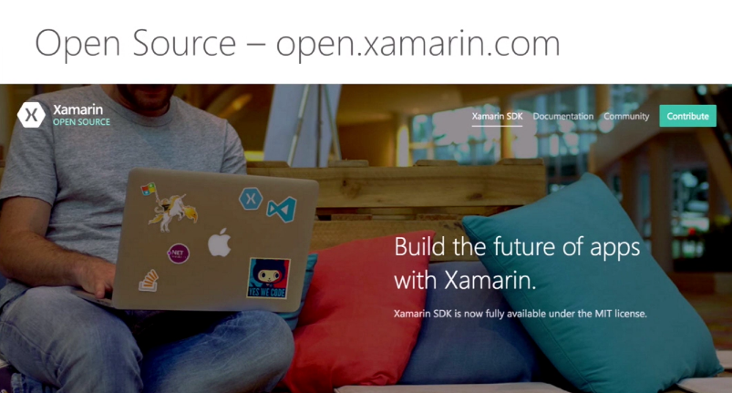
Xamarin is Open Source

Slide 16
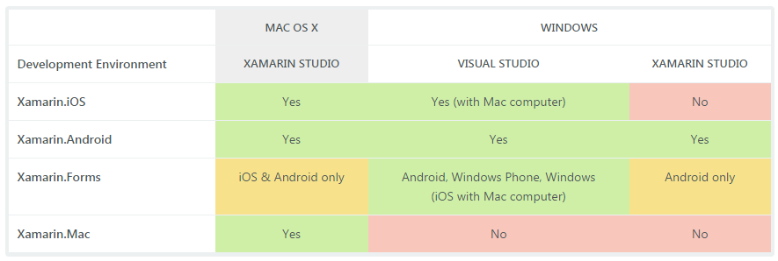
IDE: Visual Studio vs. Xamarin Studio

Slide 17
Demo Time

Slide 18
Thanks for Coming!
https://www.visualstudio.com/vs/community/
http://www.xamarin.com/download
https://developer.xamarin.com/guides/
https://university.xamarin.com/self-guided
https://github.com/xamarin/ios-samples
https://github.com/xamarin/XamarinComponents
https://github.com/xamarin/xamarin-android
https://github.com/xamarin/recipes
https://channel9.msdn.com/Events/Visual-Studio/Visual-Studio-Live-Redmond-2016/T03
https://github.com/worthingtonjg/inspirational
Jon Worthington
worthingtonjg@ldschurch.org
Ext: 25275

